Slide 1
Discovering Groups

Slide 2
Data Clustering

Slide 3
Data Clustering
Discovering and visualizing groups of things, people, or ideas that closely related
  Detect groups of customers with similar buying patterns
  Discover "fashion islands": people of similar age and income may have vastly different styles of dress
  Find groups of genes that exhibit similar behavior

Slide 4
Supervised & Unsupervised Learning
Supervised learning: use example inputs and outputs to learn how to make predictions
Unsupervised learning: not trained with examples
Purpose: find structure within data (where no one piece of data is the answer)

Slide 5
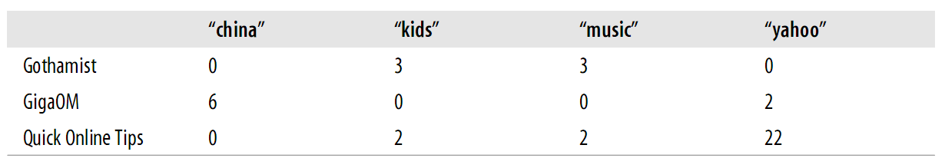
Blog Word Vectors
Blog with word used
Possible to determine
  Groups of blogs write about similar subjects
  Groups of blogs write in similar styles
Sample data: http://kiwitobes.com/clusters/blogdata.txt

Slide 6
Counting Words in RSS Feeds
Almost all blogs can be read online or via their RSS feeds
RSS feed: a simple XML document containing information about the news/blog and all the entries

Slide 7
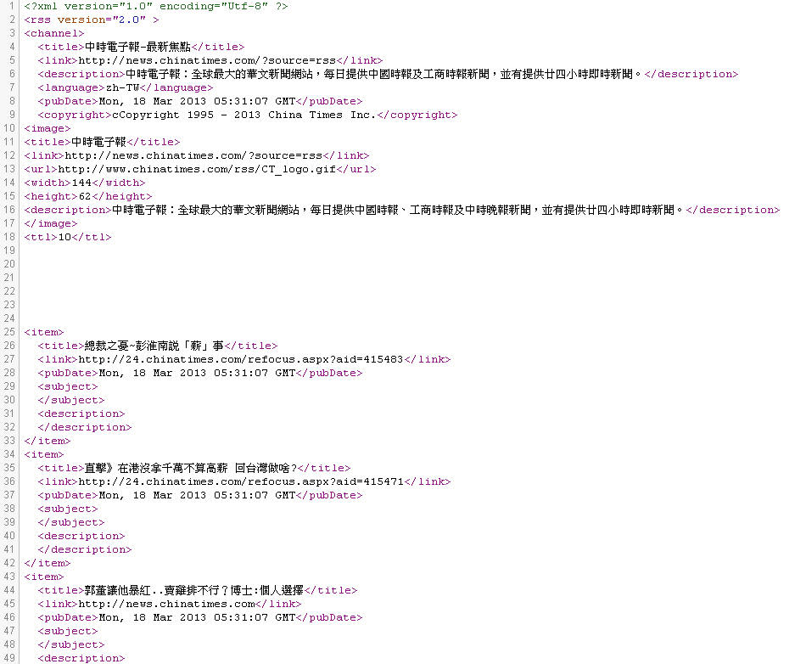
RSS Example

Slide 8
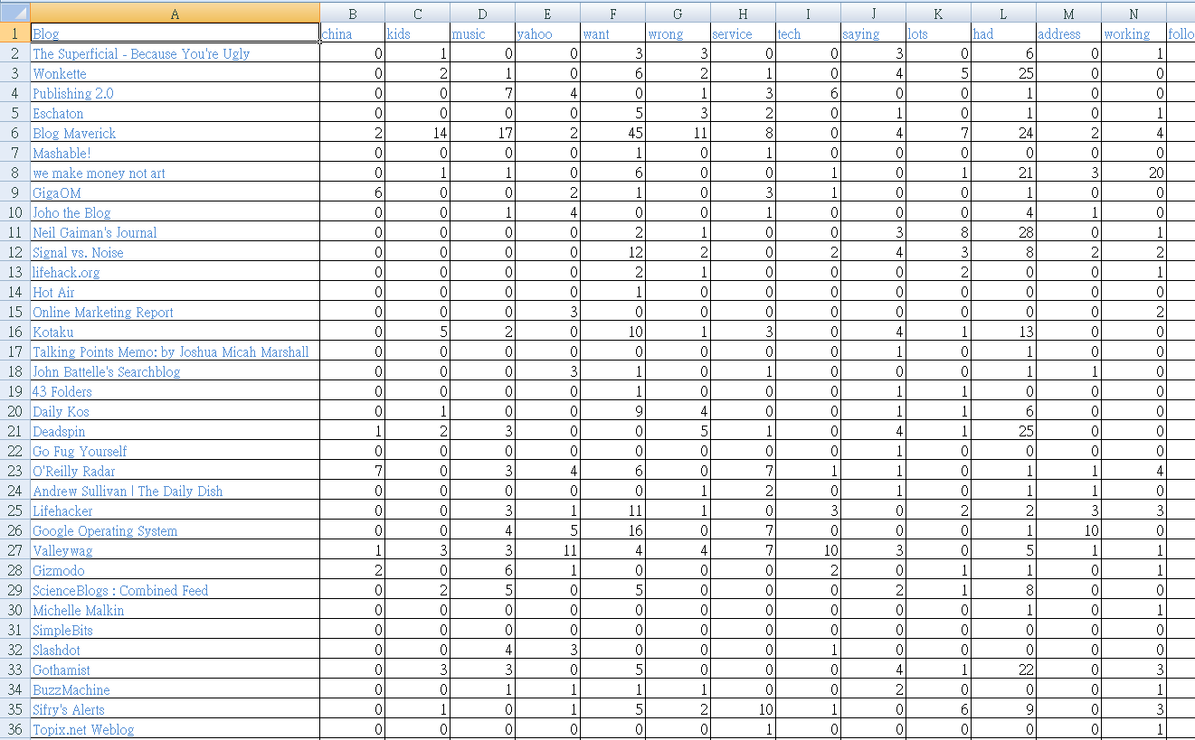
blogdata.txt

Slide 9
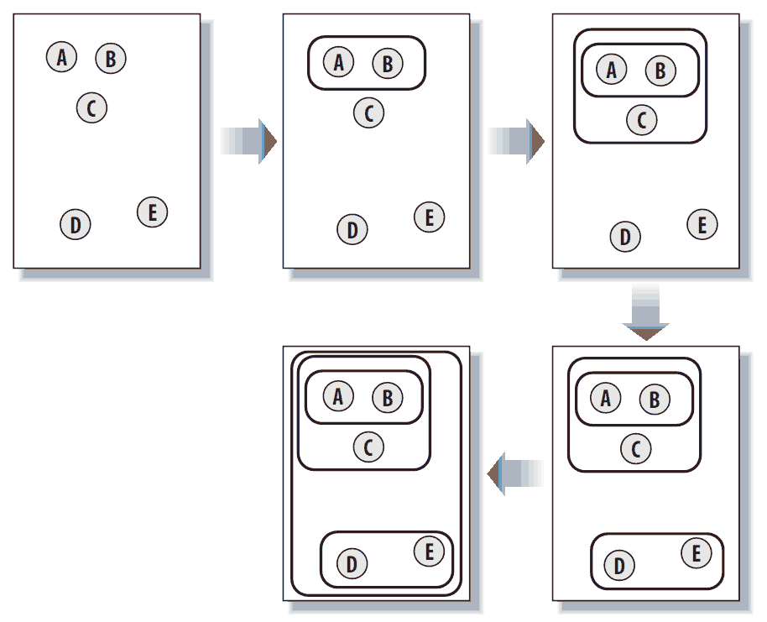
First Clustering Algorithm: HAC
HAC = Hierarchical Agglomerative Clustering
Build up a hierarchy of groups by continuously merging the two most similar groups
  Again, similarity!

Slide 10
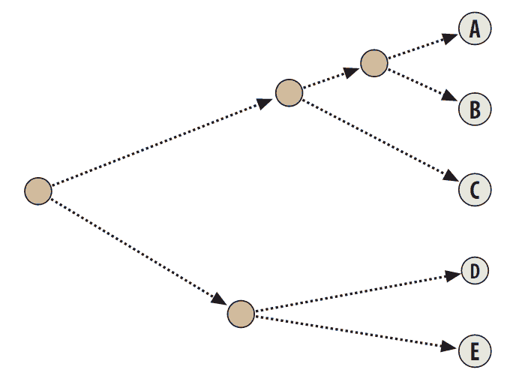
HAC Result: Dendrogram
The dendrogram not only uses connections to show cluster items, also show how far apart the items were
  eg. A-B versus D-E

Slide 11
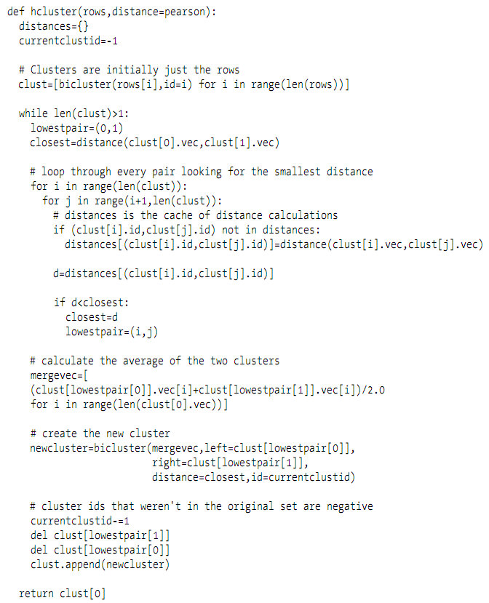
Main Flow

Slide 12
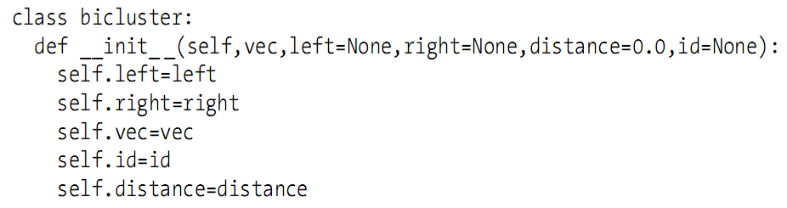
BiCluster
from: http://en.wikipedia.org/wiki/Correlation

Slide 13
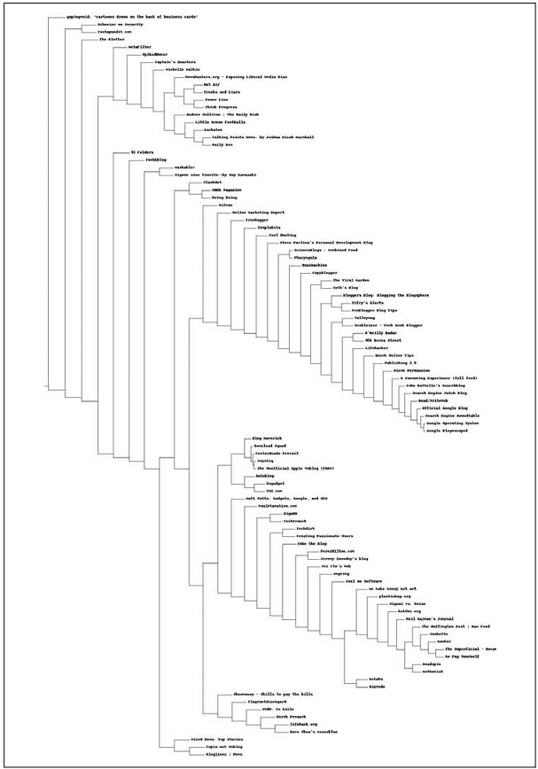
Dendrogram Printing

Slide 14
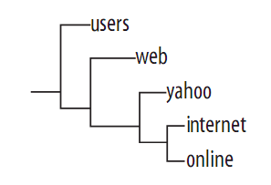
How About Transposing the Matrix?
Recall the user-based recommendation versus item-based recommendation
  Just a matrix transpose!
How about clustering with transposed matrix?
  You tell me!

Slide 15
Clustering with Transposed Matrix
Shows words used in related topics
Reflect usage patterns
  e.g. fact, us, say, very, and think
Note not all reviewers have seen all movies!

Slide 16
Second Clustering Algorithm: K-means
Disadvantage of HAC
  Tree view doesn't really break the data into distinct groups
  Algorithm is extremely computationally intensive, slow on large data
K-means clustering
  Told number of cluster in advance: “k”

Slide 17
Flow of K-means
Begins with k randomly placed centroids
Assigns every item to the nearest one (centroid)
Centroid relocation
Redo the assignments
Stop on stable assignments

Slide 18
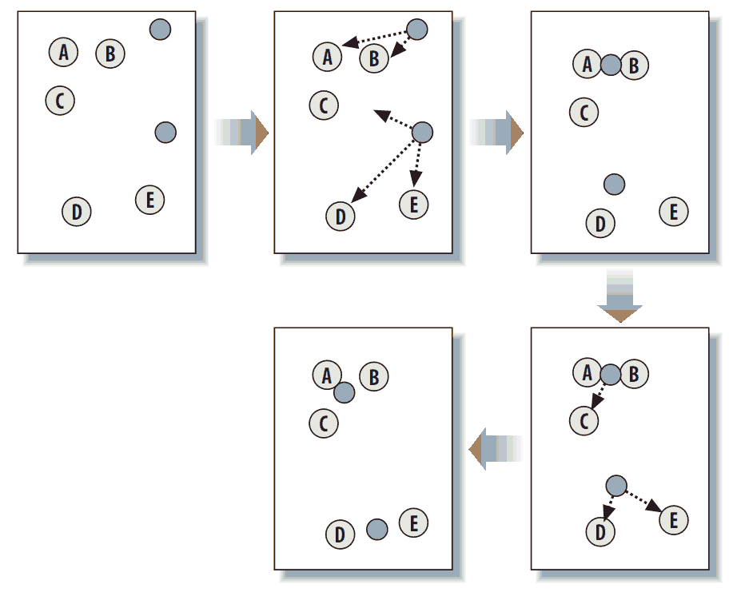
Example Flow

Slide 19
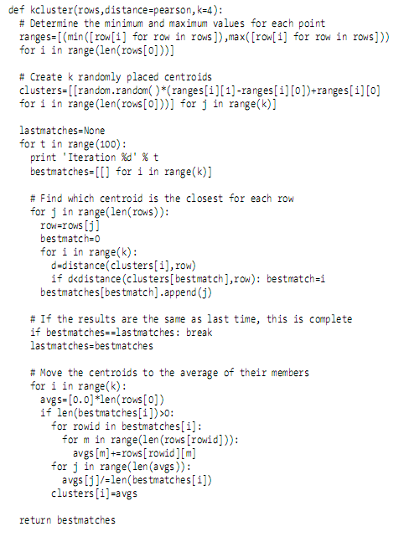
The Code

Slide 20
The Disadvantage of K-means
Random started centroids cause unstability
Homework
  Please propose TWO possible solutions to stablize k-means as good as you can
  Handwriting, at least two pages, delivered by team

